Slide 1
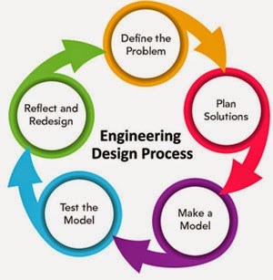
Welcome to the MakerSpace!
We are very excited to get started! Today is a day to just play and plan – have fun!
Take a look around the room - DO TOUCH!
We will start in seven minutes.

Slide 2
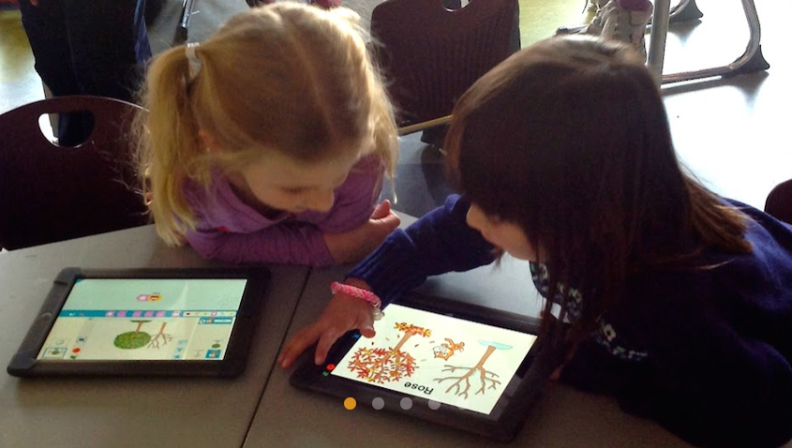
Agenda
Introduction to the MakerSpace
Introduction to today’s rotations
Intro to robotics and coding basics with Scratch, Jr.
Reflections

Slide 3
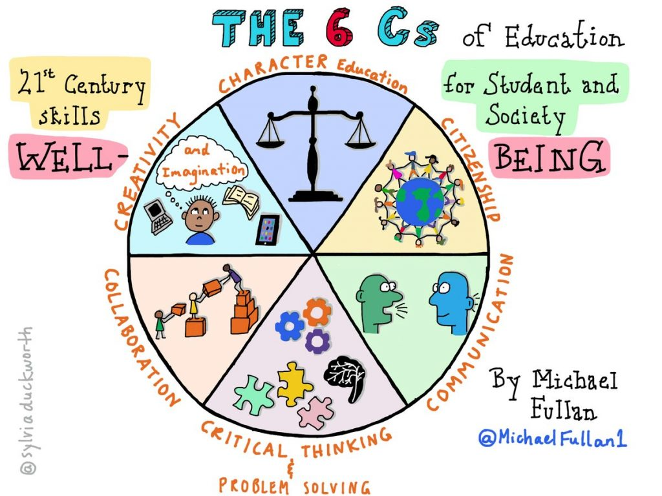
The 6 C’s of Education. Photo Credit: Michael Fullan & Sylvia Duckworth

Slide 4
Robotics Station
Play with the robots!
Make a note of any ideas you have to incorporate this into your curriculum.
Scratch, Jr. Station
Play with coding!
STREAM planning Station
Think up some curriculum related STREAM activities – use the printed sheets or the folder on the laptops if you want ideas.
Make a note of any ideas you can think of for your students to use coding in the curricular areas.
Think of one coding project and one “build it”.

Slide 5
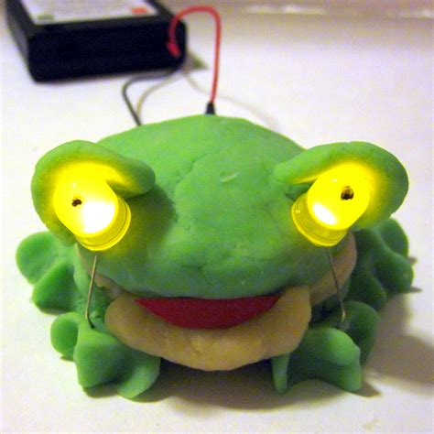
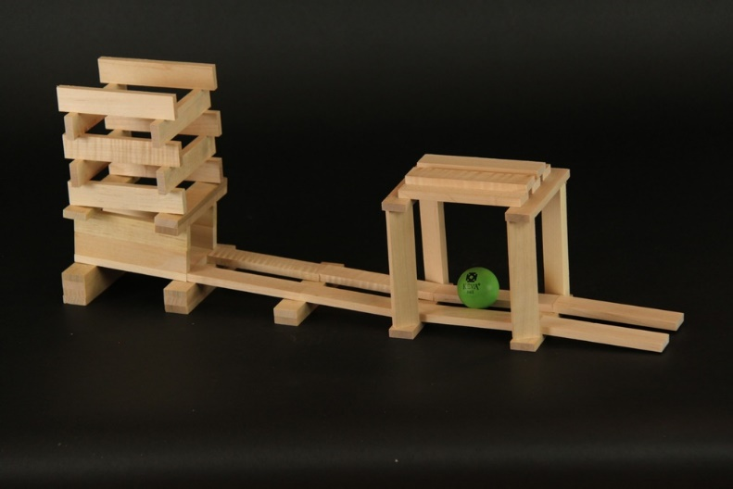
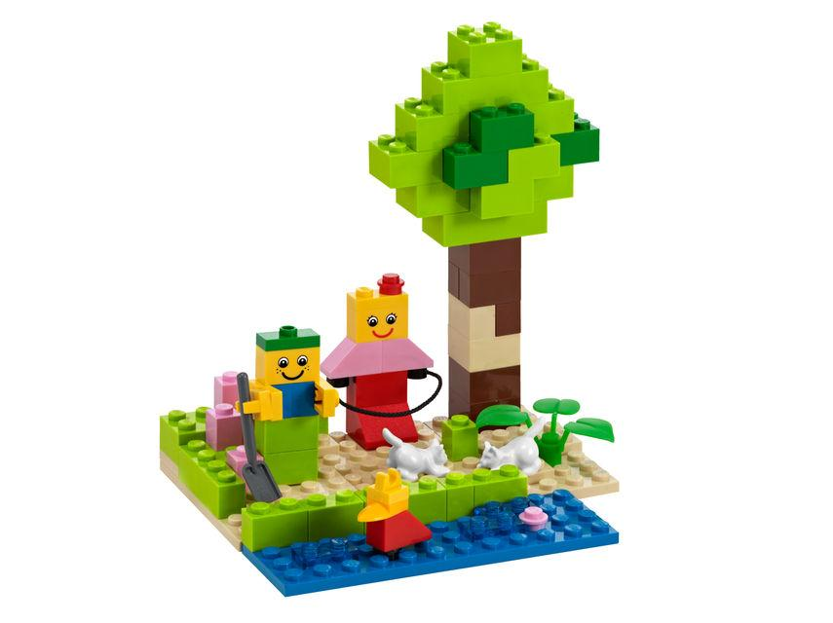
Reflections: Add anything other ideas to your note space! We will share in a couple of minutes! (grade chairs, please write a summary of GL ideas for me to keep)

Slide 6
Finally….
Make sure the MS schedule time will work.
Sign up for a computer lab time of 40 minutes.

